Slide 1

Political Beliefs, Partisanship, and Health Behaviors during the COVID-19 Pandemic
Chris Soria¹
Audrey Dorélien²
Ayesha Mahmud¹
Dennis Feehan¹
ChrisSoria@Berkeley.edu
University of California, Berkeley
University of Minnesota
Notes:
Hello everyone, I’m Chris Soria, a graduate student in the Department of Demography at Berkeley. Today, I’ll present on some early work with co-authors listed here titled 'Political Beliefs, Partisanship, and Health Behaviors During the Pandemic.

Slide 2
Background
Mathematical models for studying COVID-19 transmission have typically not incorporated heterogeneity in behavior by political party affiliation (Lloyd-Smith, J.O., et al., 2005)
Excess mortality for COVID-19 was significantly higher for Republican voters than Democratic voters (Wallace, A., Goldsmith-Pinkham, P., & Schwartz, J. , 2023; Gallup, 2020)
Party affiliation is associated with health-related behaviors
Individual and local partisan context results (Baxter-King, R., et al., 2022)
Notes:
As we all know, infectious diseases spread through close interpersonal contacts, and the risk of transmission increases with the frequency of these contacts, especially if precautionary measures aren’t taken. Disease models incorporate these factors to predict and describe the extent and rate of disease spread. However, our research was inspired by the observation that traditional disease models used during the pandemic often assumed that individuals within a population have the same chance of getting infected. However, different groups differ in the behaviors which can spread diseases. For example, during the pandemic people differed in their willingness to reduce contact with people beyond their household, whether they wore face-masks, and whether they got vaccinated.
Our literature review also showed that existing research utilizing these disease models does not differentiate between Democrats and Republicans, even though there's a lot of evidence of different health behaviors during the pandemic between these groups. This variation may have played a role in the higher mortality rates among Republicans that Wallace, Goldsmith-Pinkham, and Schwartz found in Florida and Ohio.
Beyond categorical differences between Democrats and Republicans, there’s also some evidence that local population partisan context plays a role. For example, Ryan Baxter-King and collaborators found that Republicans are less likely to wear masks when they live in ZIP codes where other registered Republicans are the majority.

Slide 3
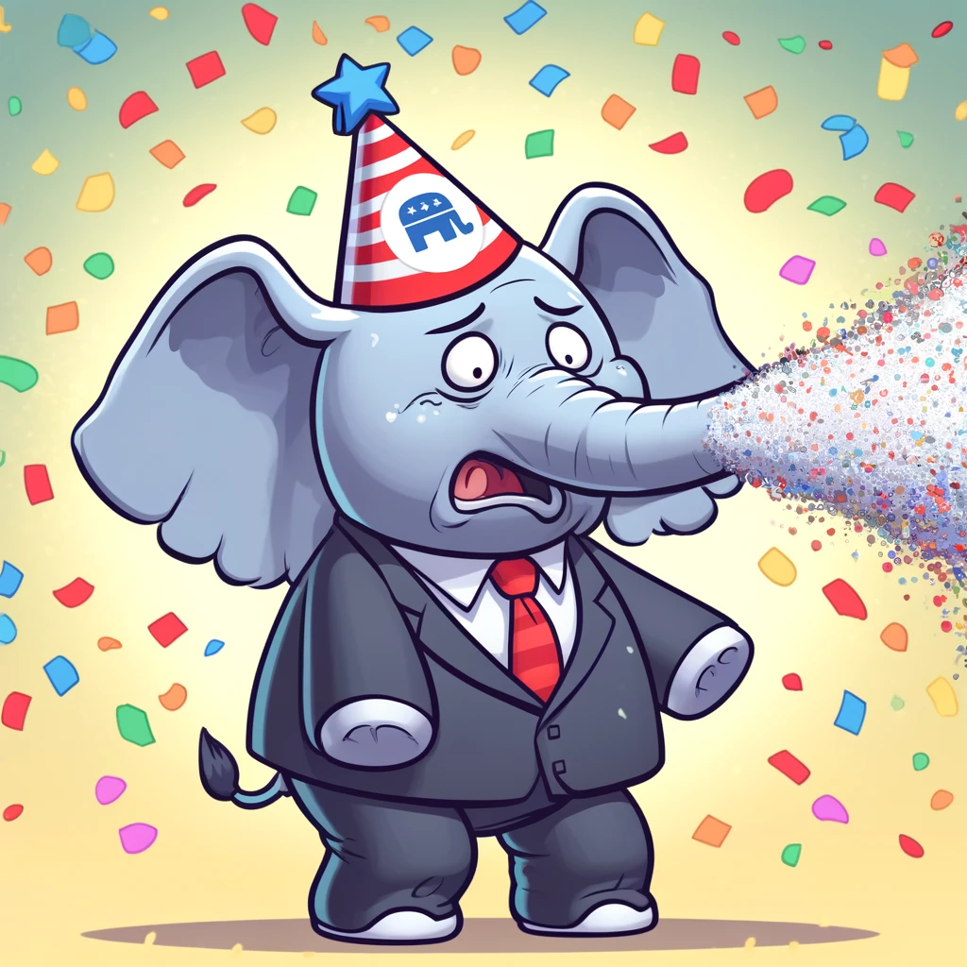
Our Contributions/ Research Questions
How did individual political affiliation and the local partisan context impact health behaviors during the pandemic?
Behaviors: contact rates, mask use, vaccination
Partisanship and prevalence dependent behavior
What are the implications for the spread of infectious diseases in heterogeneous populations?
Notes:
In this study, we aim to contribute to the conversation with the following research questions:
How did individual political affiliation and local partisan context impact health behaviors during the pandemic? Specifically, non-household contact rates, mask-usage, and vaccination uptake.
To what extent are partisan groups responsive to changes in COVID-19 incidence rates?
How can the insights from the first two questions be integrated into disease models that account for partisan identification?
During this presentation, I’m going to focus primarily on the first question, but I’ll briefly talk about where we’re hoping to go with this, and I’m really interested in gathering feedback and suggestions on how to move this forward.

Slide 4
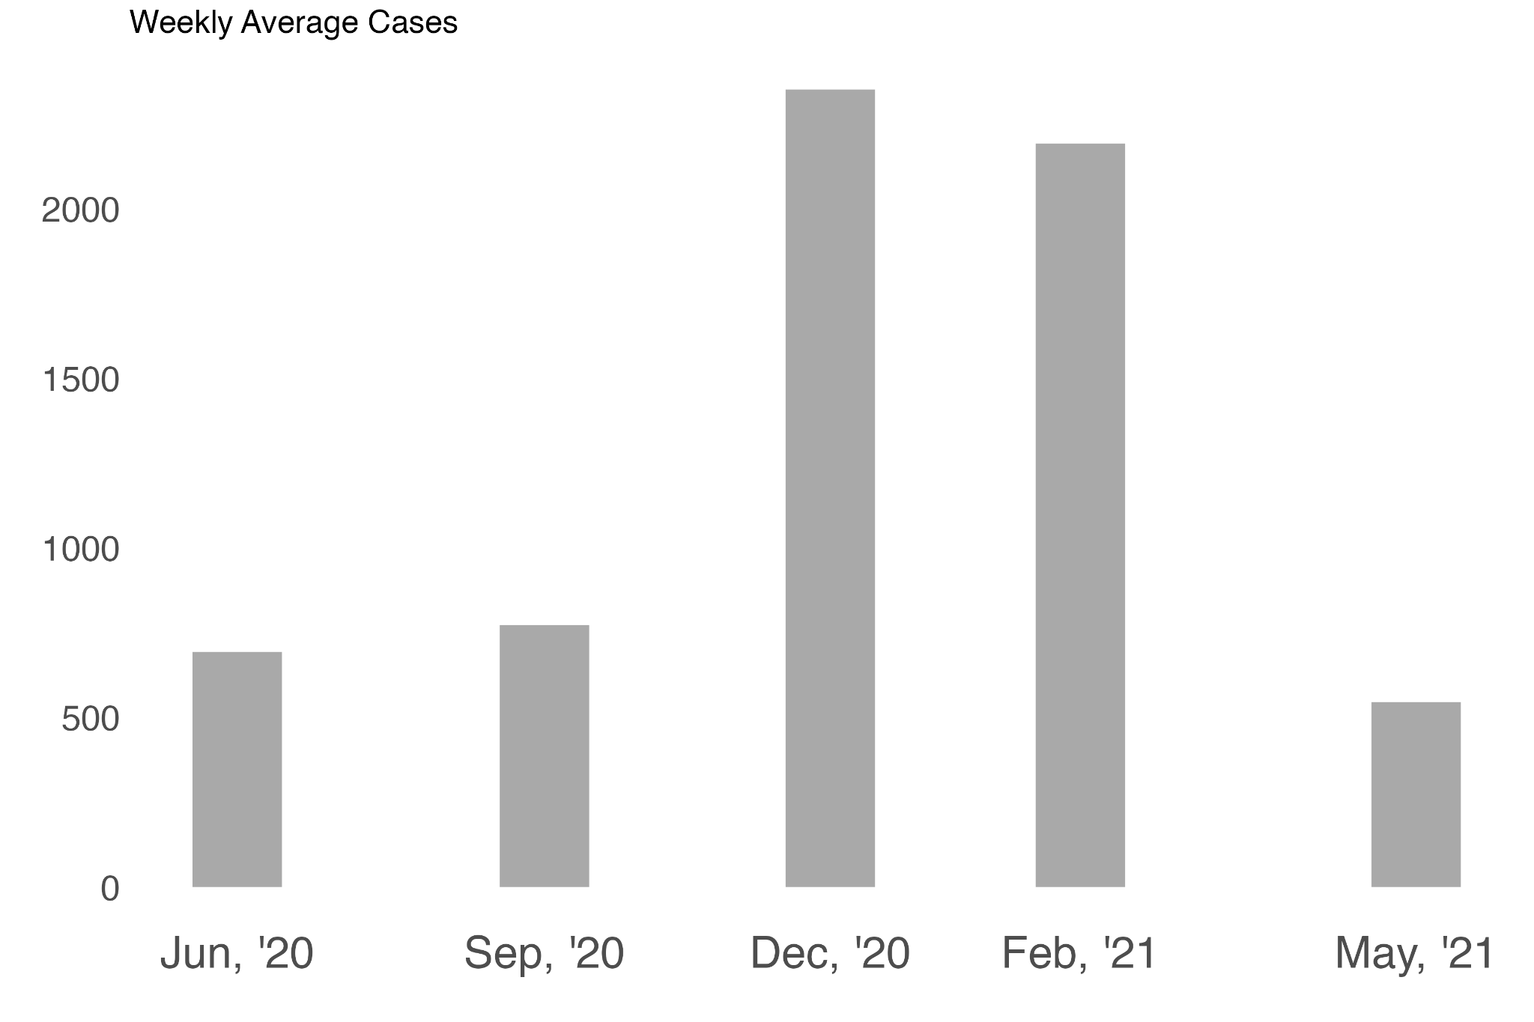
Berkeley Interpersonal Contact Surveys (BICS)
COVID-19 7-day average daily deaths
Wave | Sample Size
2 (June ‘20) | 2,309
3 (Sept ‘20) | 3,216
4 (Dec ‘20) | 2,976
5 (Feb ‘21) | 2,958
6 (May ‘21) | 5,345
Total | 16,804
Omicron variant leads to a record number of cases
The U.S. COVID-19 death toll surpasses 100,000
FDA authorizes the vaccine for children 5 through 11 years of age
Joe Biden takes office
FDA authorized the vaccine for emergency use
Source: Johns Hopkins Coronavirus Resource Center
Notes:
To answer this question, we used data from five separate cross-sections taken by the Berkeley Interpersonal Contacts Study (BICS), covering dates from June 2020 to May 2021. The 5 waves are presented in this plot here in the x axis, where the y axis represents the national 7-day average daily covid death counts and throughout it I added some key events. This data includes responses from a national sample, along with sub-samples from specific cities. For our analysis, we used the combined data from all these samples and to accurately reflect the national population, we applied weights and controlled for where the samples came from. It’s important to note that the survey started to ask about vaccination in its sixth round in May 2021.

Slide 5
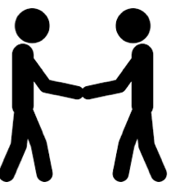
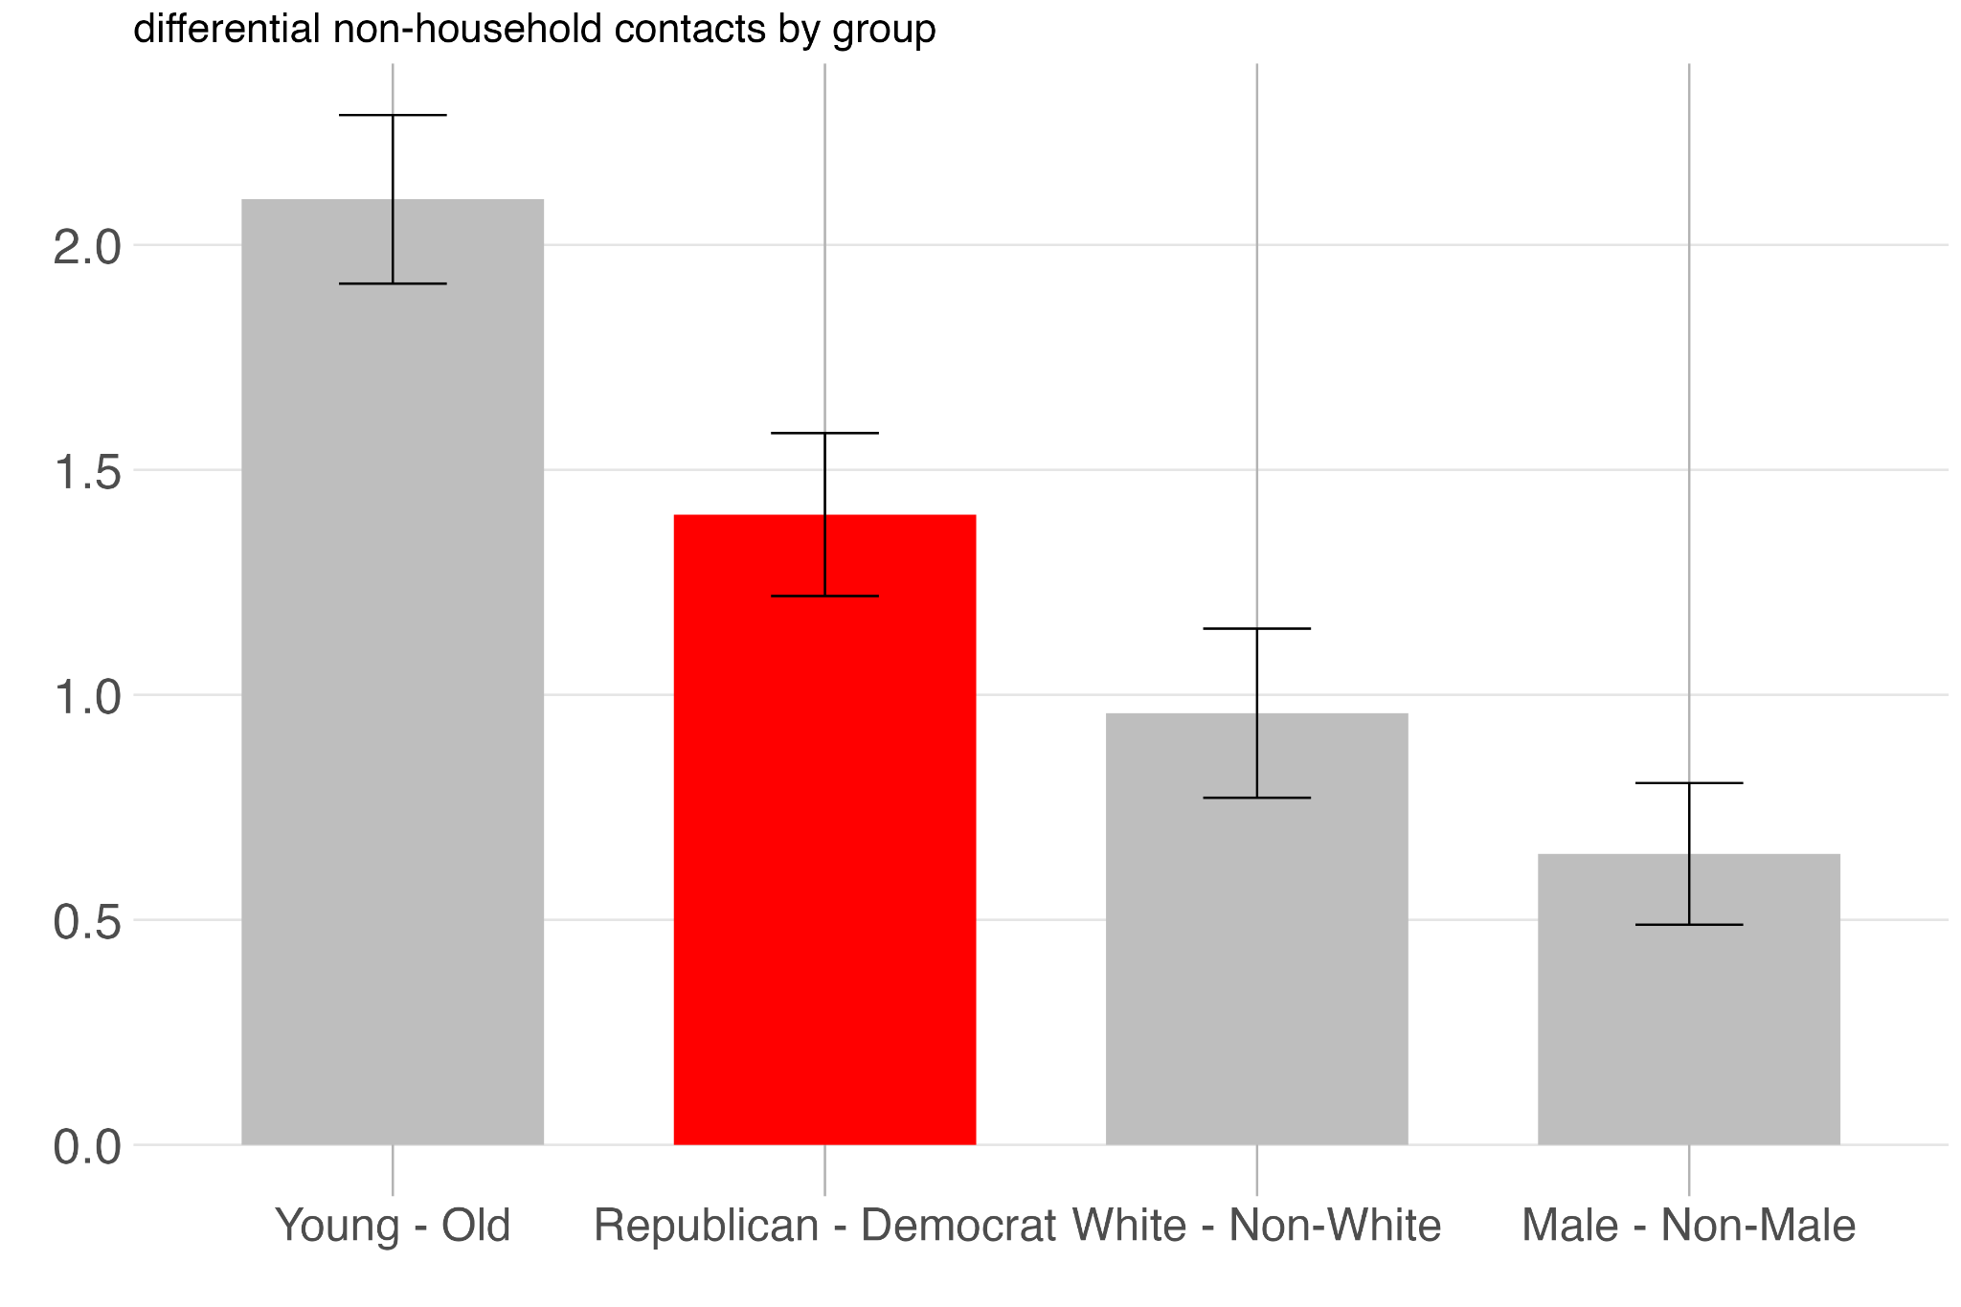
Partisan differences in contact rates are greater than racial and gender differences
How many people who do not live in your household did you have in-person contact with yesterday?
Source: BICS Pooled Data (June 2020–May 2021)
Notes:
Before I get to results, I just want to give you all a sense of the magnitude of the gap between Republicans and Democrats. This plot shows the raw differences between comparative groups in the number of contacts people had with those outside of their homes. This is based on the day before the survey was taken. Each bar represents the subtractive difference between group A and group B, with positive numbers indicating higher contacts in the first group compared to the second. For example, the 'Republican - Democrat' bar shown in red signifies a higher number of non-household contacts among Republicans compared to Democrats. This gap is larger than gender and race-based differences, but not quite as large as young versus old, which were defining as 65 and older.

Slide 6
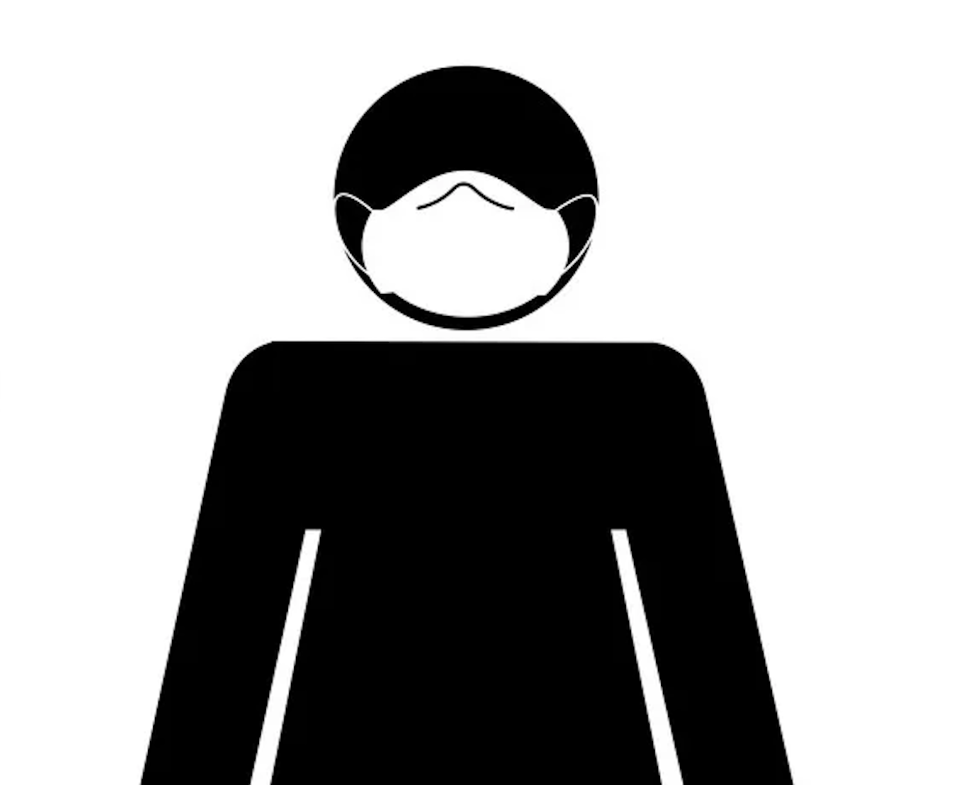
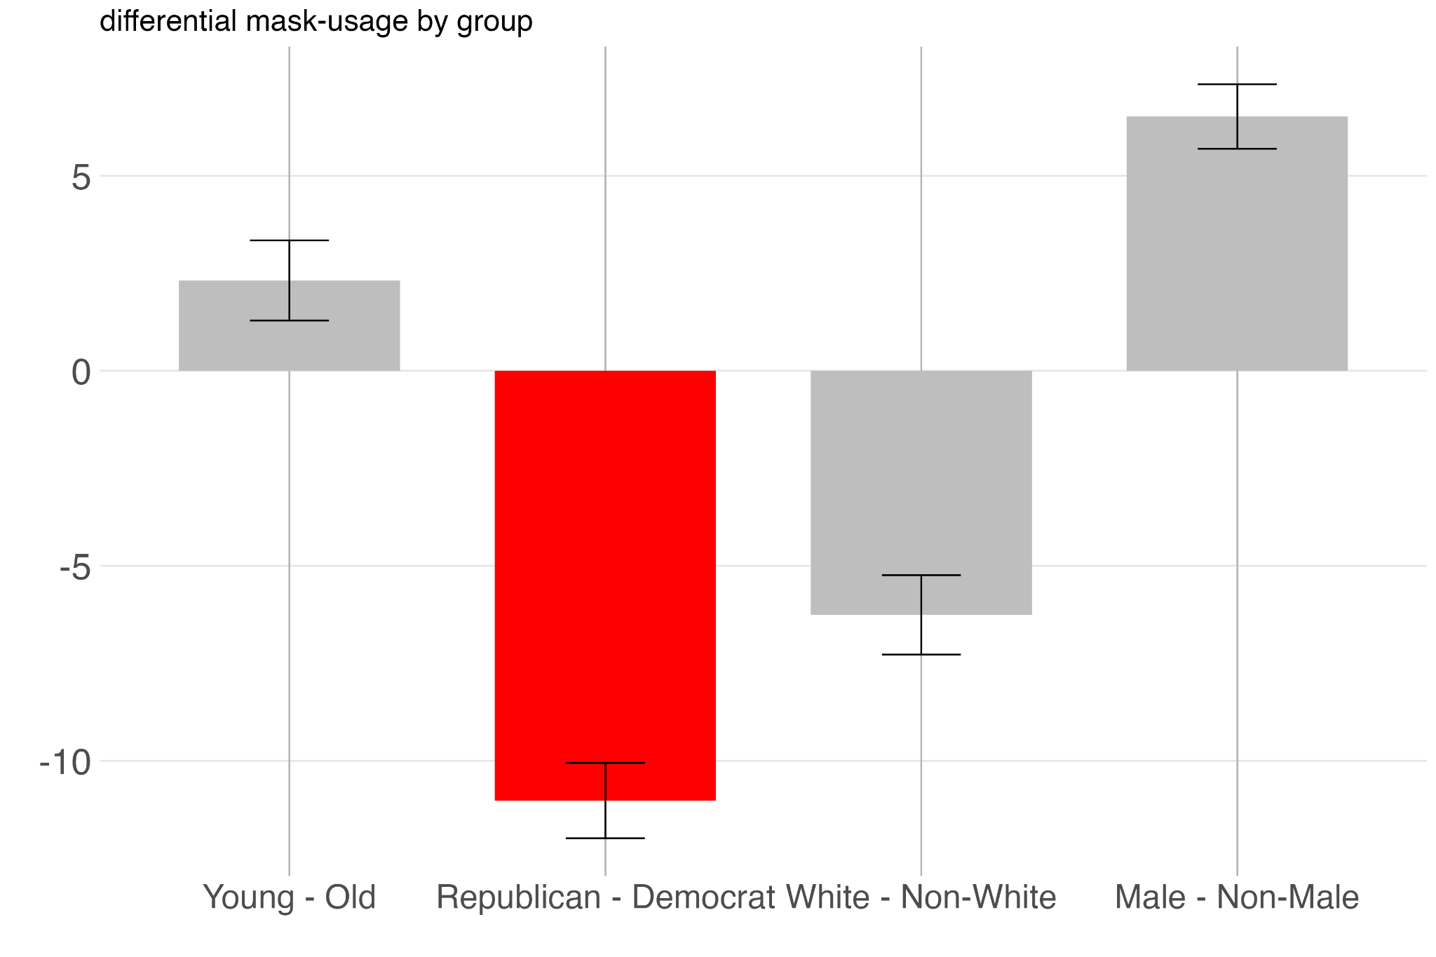
Biggest differences in mask usage are based on partisan differences!
During this contact, did you wear a face mask?
Source: BICS Pooled Data (June 2020–May 2021)
Notes:
If participants mentioned they had any contacts outside their home, they were then asked about their mask usage in up to three of those encounters.
Here, a negative value indicates a lower percentage of reported contacts carried out while the respondent was using a mask. This time, the biggest difference is between Republican and Democrat, where Republicans are wearing masks 10 percent less than Democrats.

Slide 7
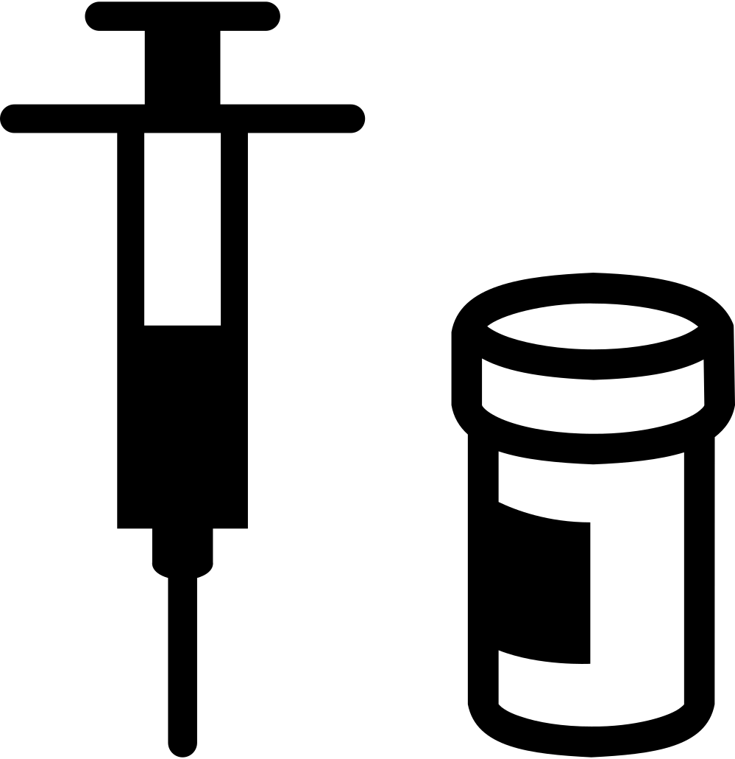
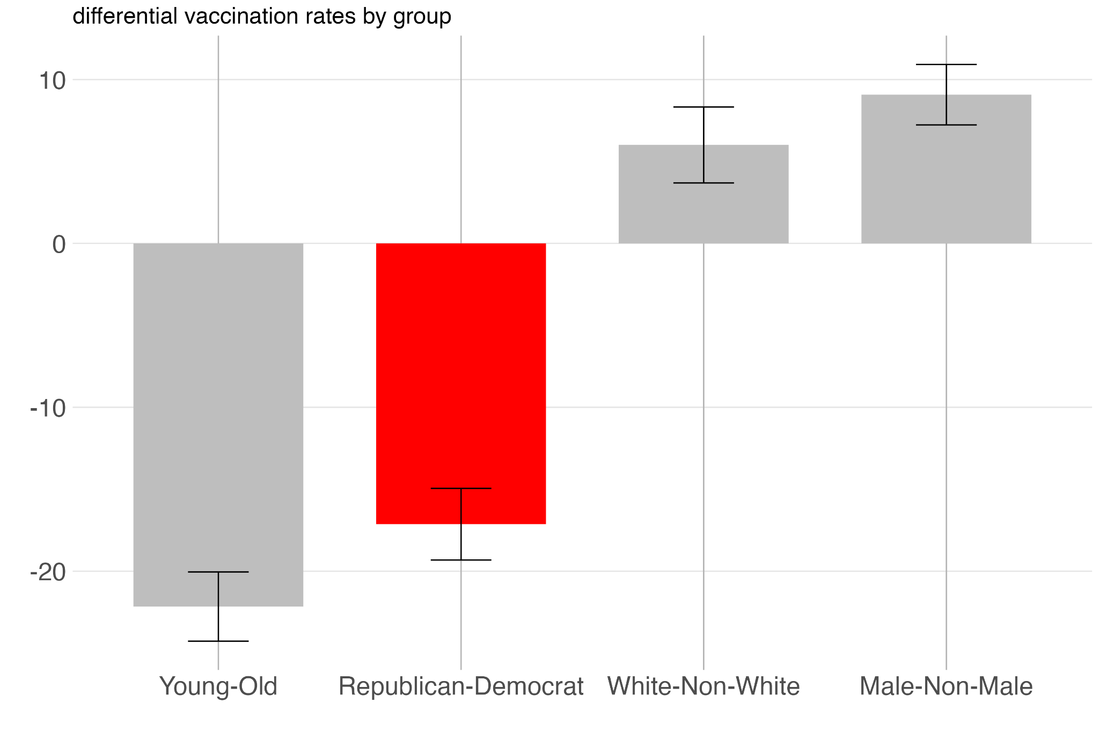
Partisan differences in vaccination rates are also large
Have you gotten vaccinated against COVID-19?
Source: BICS (May 2021)
Notes:
Lastly, the percent chance of vaccination differences are largest for young versus old but also large for Republican versus Democrat.

Slide 8
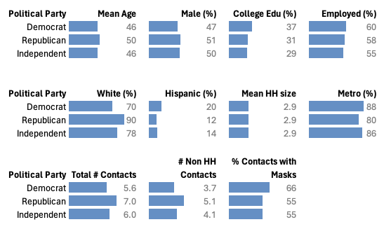
Republicans and Democrats are different but these differences don’t drive our results
Source: BICS Pooled Data (June 2020–May 2021)
Notes:
And this is despite Republicans being older on average compared to Democrats! They’re also more white, more male, less likely to be college educated or to live in metro urban counties, but their household sizes are similar.
Wait 5 seconds.

Slide 9
Methods
Full List of Controls
Race
Gender
Age
Education
Household Size
County Urbanicity
County Mask Mandate
County Incidence Rate
Survey Wave
Sample Source
Utilized multivariate linear models to extract estimated marginal means.
Sum of non-HH contacts
Percentage of contacts where the respondent wore a mask
Vaccination rates
Contextual factors
Analyzed at the county level: Rural vs. urban distinctions, incidence rates, and mask mandates.
Incidence rate models include county-fixed effects to control for local variations.
Notes:
In the following results, we control for all of the previously mentioned factors, alongside county-level mask requirement policy and per capita incidence rates. In this early analysis, we employed multivariate linear models to derive estimated marginal means for key variables. We incorporated data from historical GitHub commits produced by Johns Hopkins to ensure that we were capturing information as it was being received by respondents in real time.

Slide 10
Results
Non-Household Contacts
Percent of Contacts with a Mask
Percent Chance of Vaccination
Democrat
Republican
Independent
Notes:
In the following results, first, I’ll present on non-household contacts, then mask usage, and finally on percent chance of vaccination. Democrats will always be in blue, republicans in red, and independents in green.

Slide 11
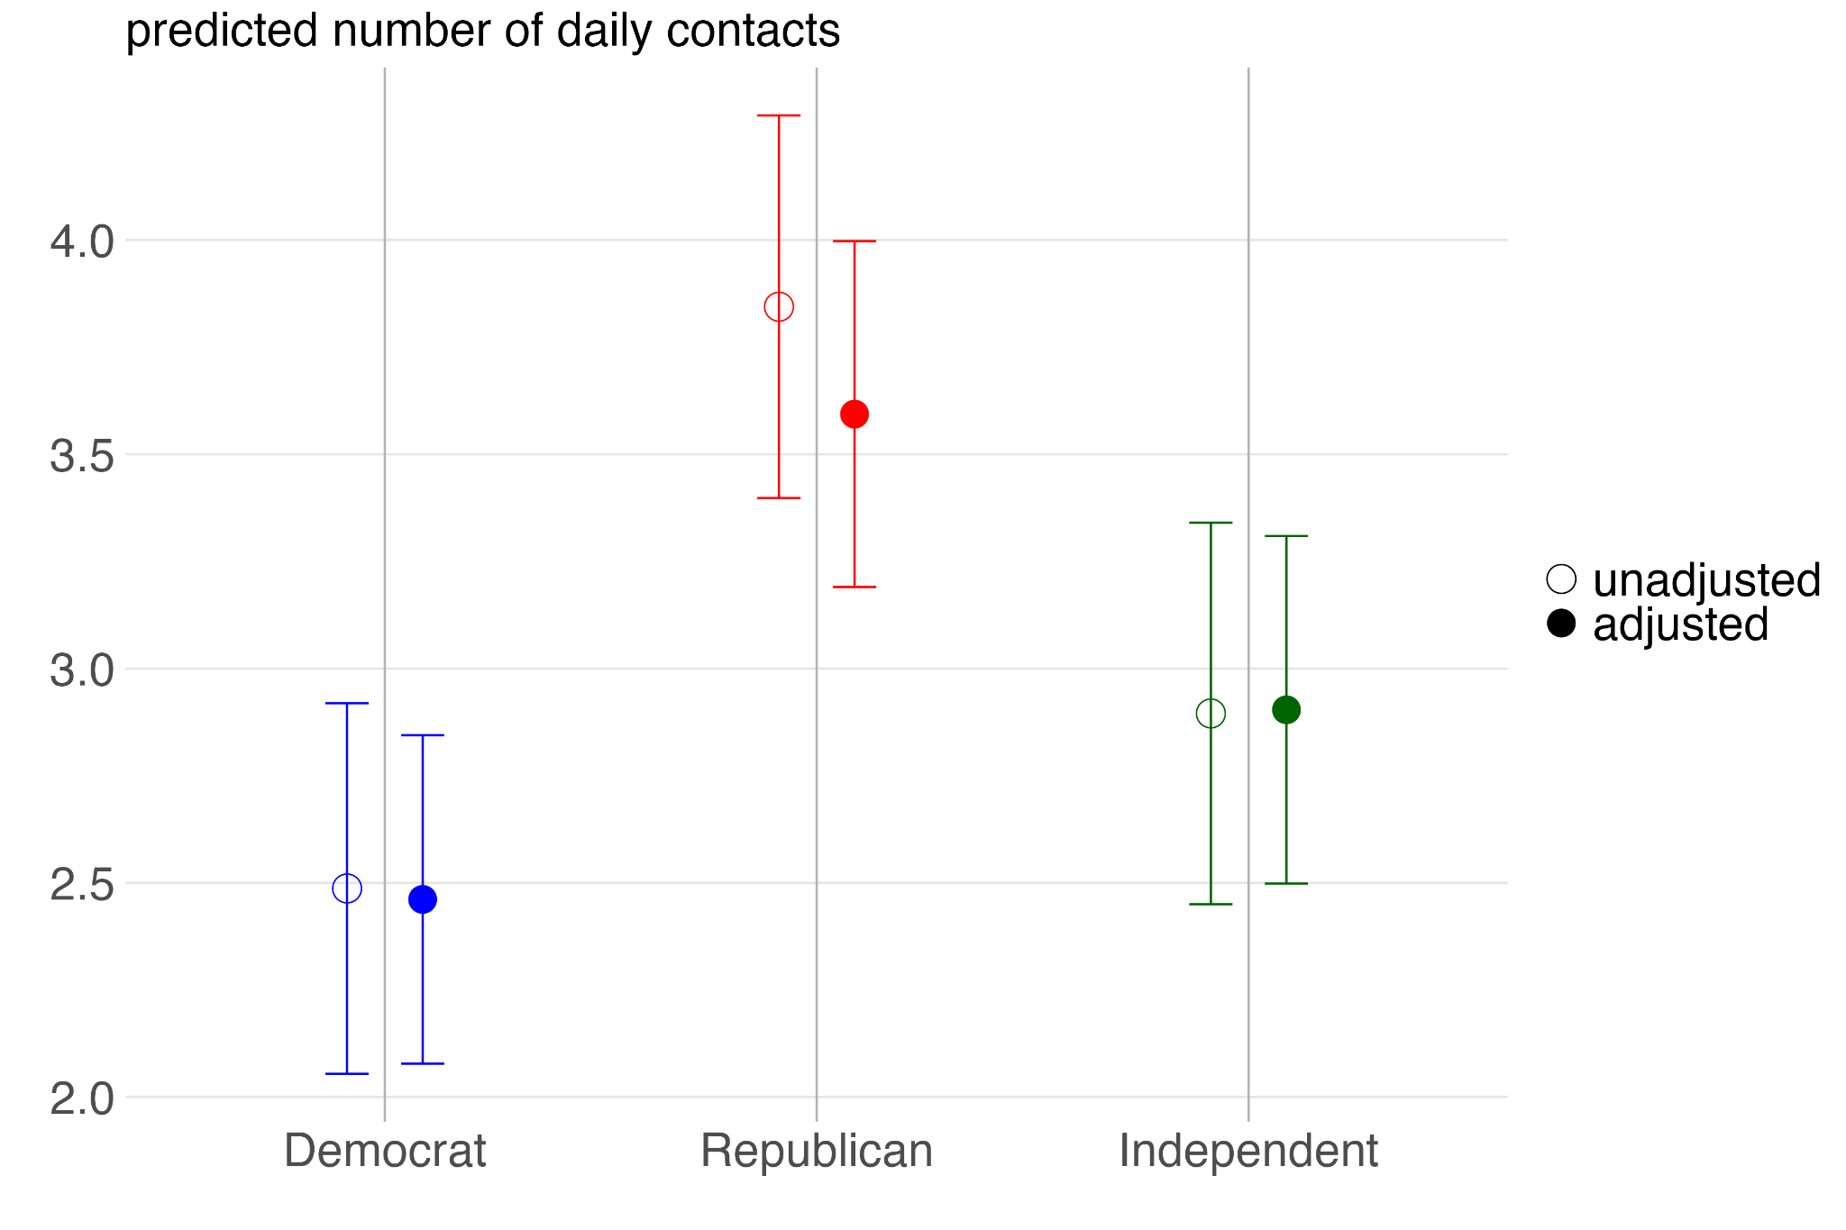
Democrats have fewer non-household contacts throughout the pandemic
Notes:
Here we can see that political party affiliation, on the x axis, is associated with differences in the number of non-household contacts, on the y axis, throughout the pandemic. We estimated that Republicans had an average of about 3.5 contacts compared to Democrats’ 2.5. The pattern holds in the adjusted model, as represented by the filled dots, compared to the unadjusted model with the hollow dots.

Slide 12
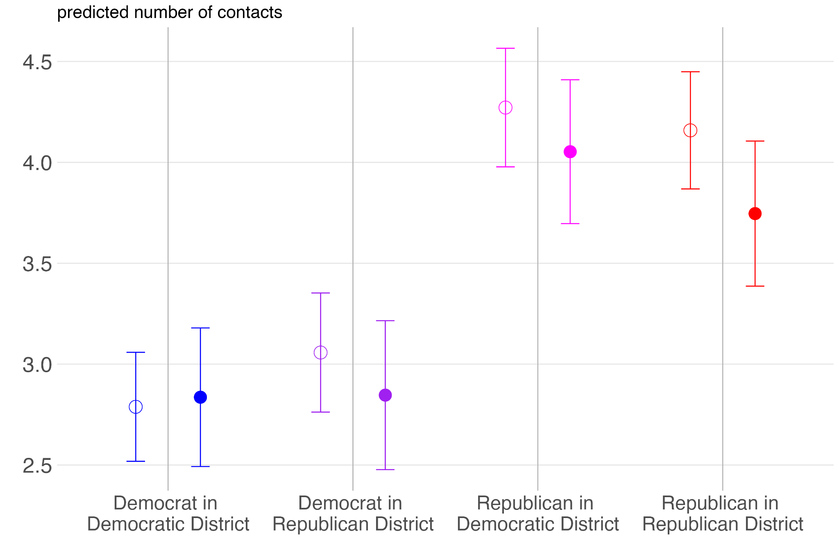
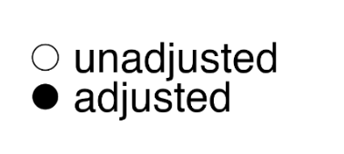
Partisan non-household contacts do not vary
much by local partisan context
Notes:
Contrary to other upcoming results, non-household contact patterns aren’t impacted by partisan context. For example, regardless of whether they’re in Democratic or Republican congressional districts, Democrats report the same average daily contacts throughout the pandemic.

Slide 13
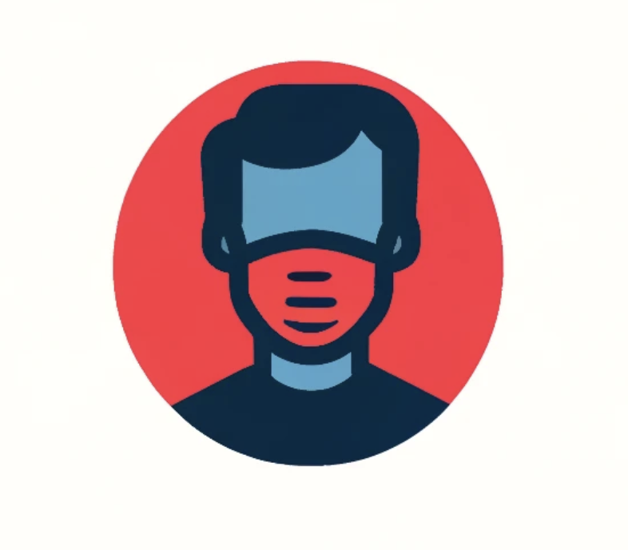
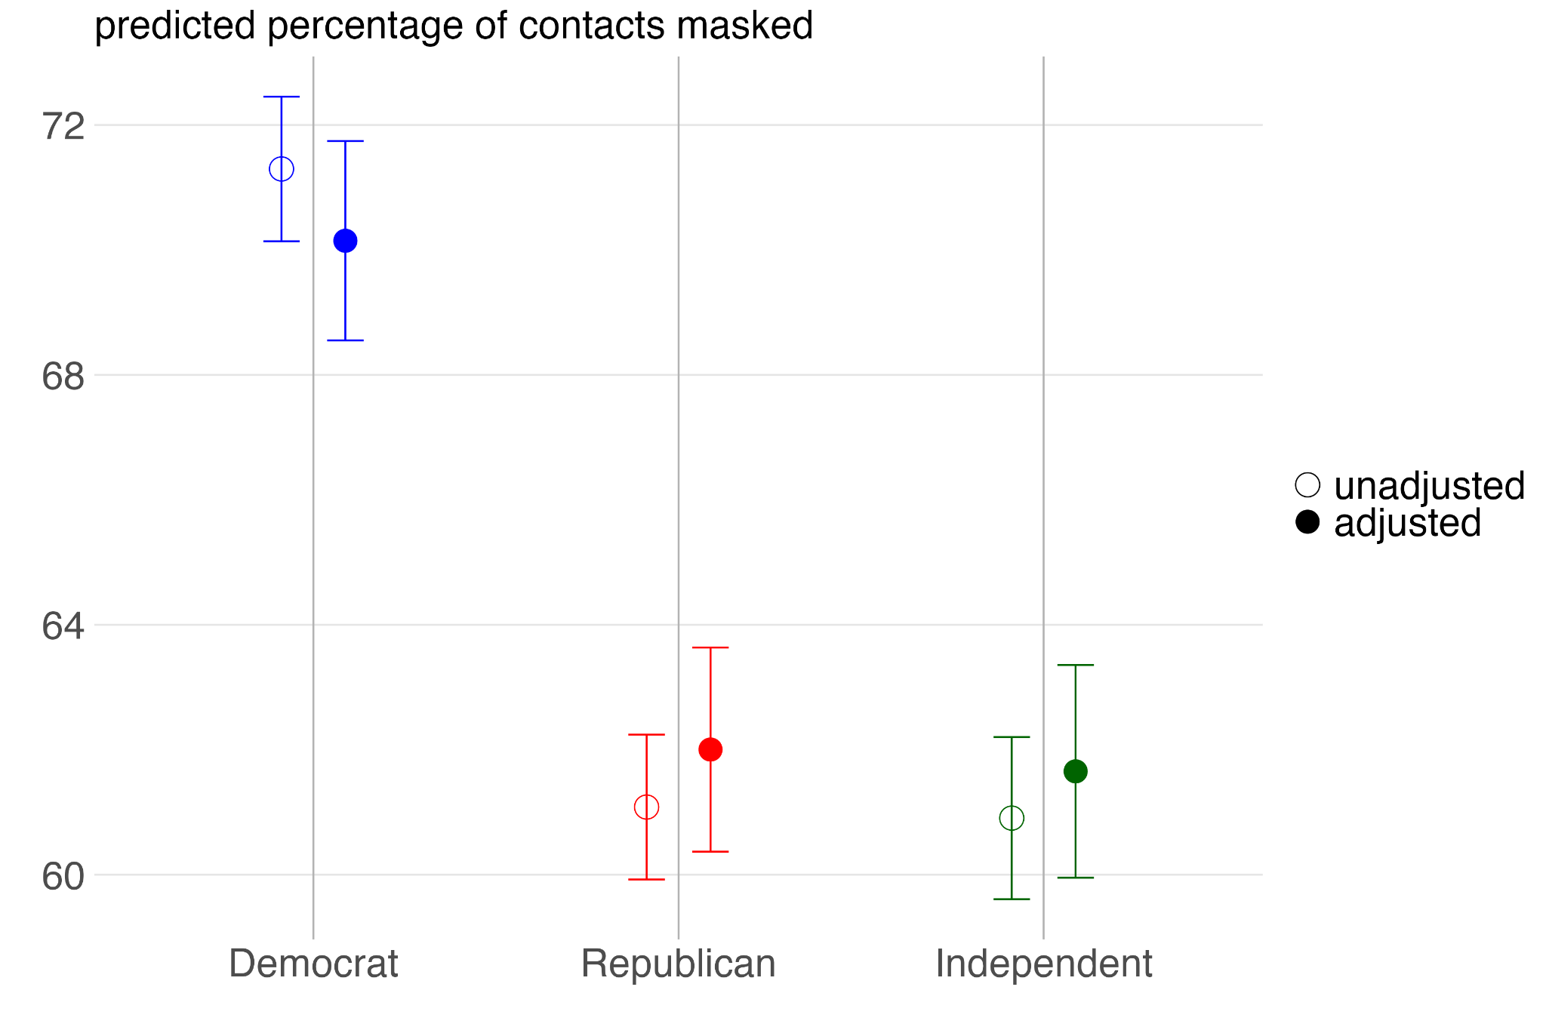
Democrats are more likely to report wearing a
mask throughout the pandemic
Notes:
When Democrats mention having any kind of contact with others, they also report a higher percentage of mask usage. In line with raw averages, Democrats use face masks around 10% more than Republicans when interacting with people beyond their household.

Slide 14
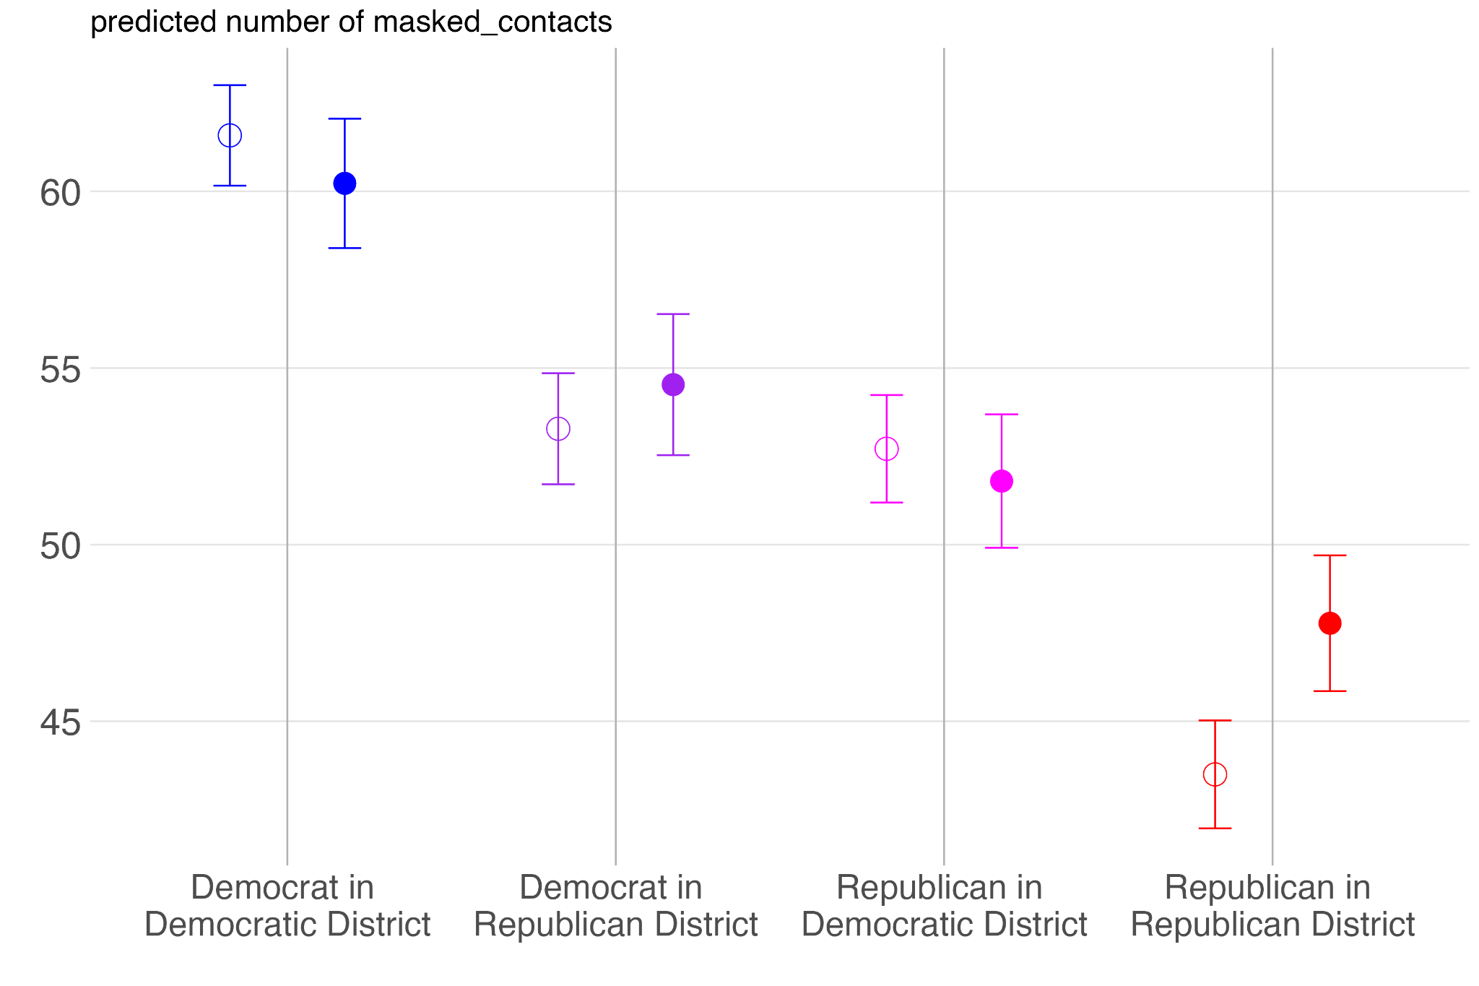
Local partisan context is associated with reported mask usage for both Democrats and Republicans
Notes:
However, when Democrats are minorities in republican districts, their mask-usage rates move down to be more similar to the majority. And, when republicans are minorities in democratic districts, their mask usage is higher. In other words, both Democrats and Republicans are less likely to use masks when Republicans are the in the majority.
(Pause 5 seconds)

Slide 15
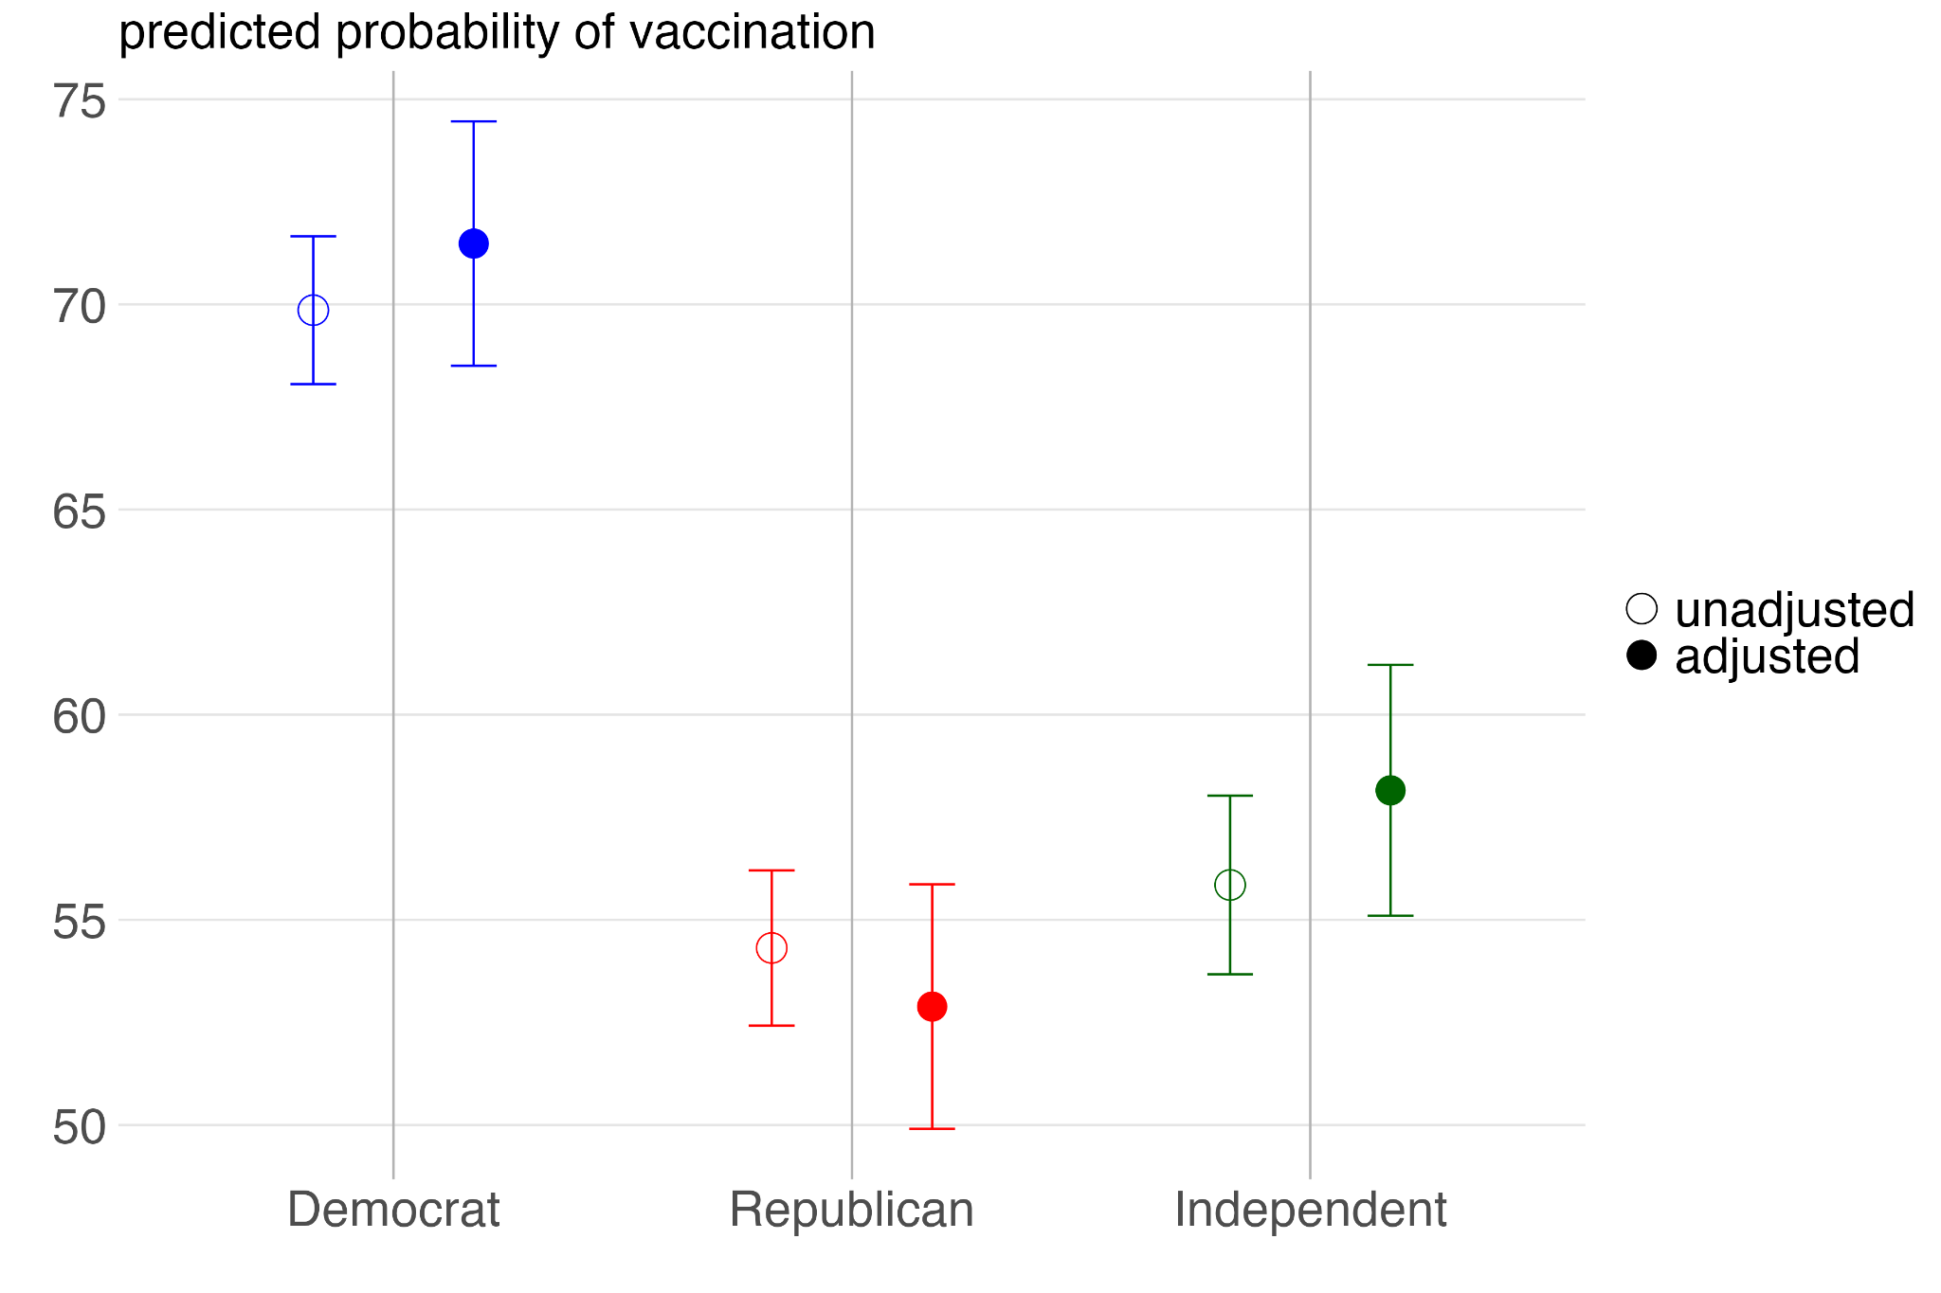
Democrats are more likely to report being vaccinated
Source: BICS May 2021
Notes:
And for vaccination, democrats are much more likely to have reported being vaccinated as of May 2021 compared to both Republicans and Independents.

Slide 16
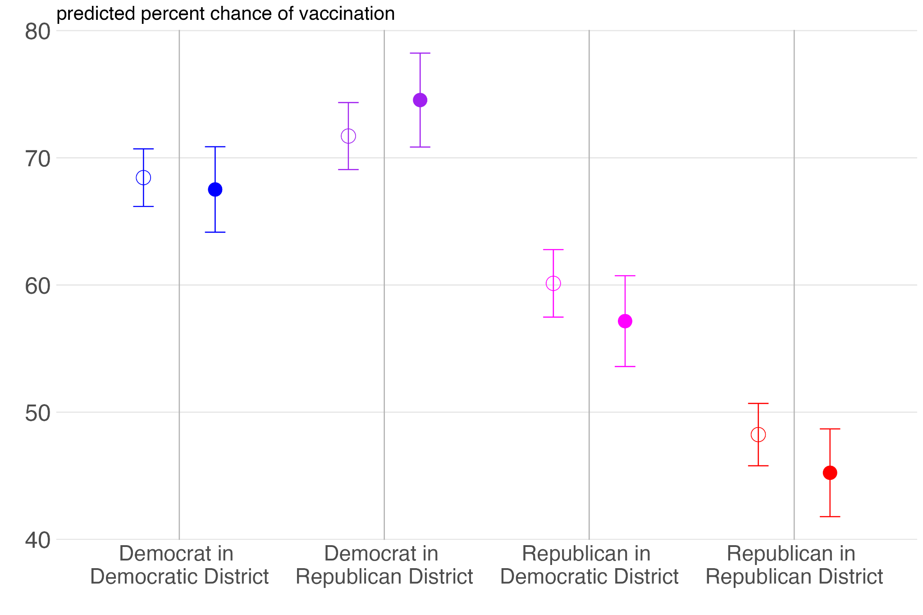
Republican are even less likely to report being vaccinated in Republican districts
Source: BICS May 2021
Notes:
Interestingly, Democrats are more likely to get vaccinated when they live in Republican-majority areas, even though they wear masks less often in these areas. On the other hand, Republicans are less inclined to get vaccinated when they’re majorities amongst fellow Republicans.

Slide 17
Why does this matter?
Notes:
So why does all this matter and how does it fit into what we’re trying to do?

Slide 18
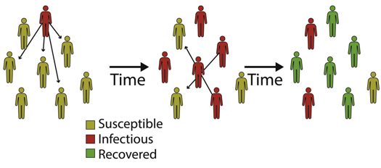

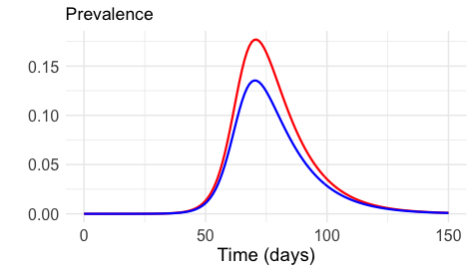
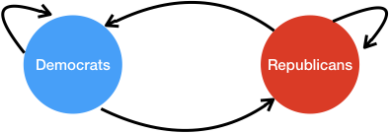
Epidemic dynamics are sensitive to changes in contact rates
Xavier et al. (2022)
Notes:
The goal is for these findings to help us inform a disease model, which can help us understand how quickly infection can spread by predicting the number of people who will become infected over time and how the disease will progress through a population. However, without a solid understanding of what factors contribute to contact rates and preventative behavior adoption, we cannot produce accurate estimates.
As I hope I’ve shown in the previous slides, political affiliation is a major predictor of behavior during the pandemic and therefore important to account for in disease modeling.
In the bottom right, I'm presenting results from a basic heterogeneous SIR model that accounts only for differential contact rates. This model shows how such differences can lead to varied disease projections. Specifically, it illustrates that Republican prevalence rates peak higher, solely due to these varying rates of contact, which could translate to higher mortality rates.

Slide 19
Conclusion
Democrats and Republicans differ greatly in their contact rates, mask usage, and vaccination rates during the pandemic
Congressional district context matters for understanding partisan behavior
Mask usage most sensitive to partisan context
Social pressure or selection effect?
Notes:
Selection effect, where people are selecting where they live based on lifestyle preferences that are corelated with political preferences.
Another explanation is social pressure or public conformity, where republicans are adopting the mask-usage behaviors of democrats when they are in the minority but are doing so less often when they are in the majority.

Slide 20
Thank you!
Funding:
Berkeley Population Center pilot grant (NICHD P2CHD073964); Hellman Fellows Program (Dennis Feehan).
Dorélien acknowledges support from the Minnesota Population Center (P2C HD041023) funded through a grant from the Eunice Kennedy Shriver National Institute for Child Health and Human Development (NICHD)
Email Suggestions:
ChrisSoria@Berkeley.edu
Notes:
Thank you for your time.

Slide 21
Additional Slides

Slide 22
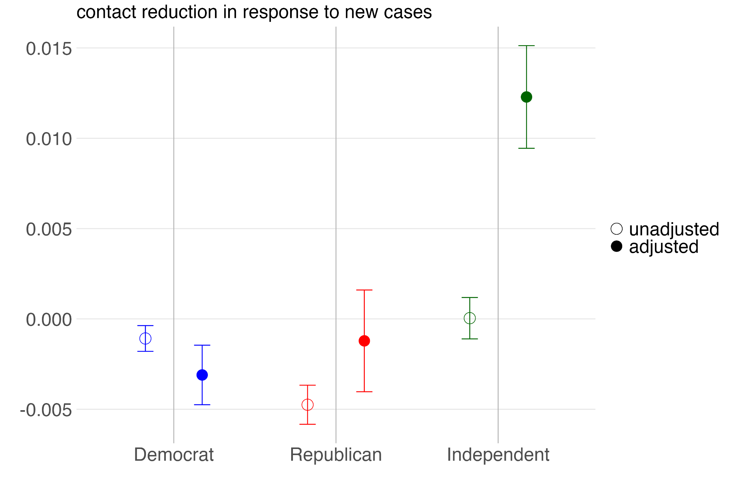
Republican non-household contact behavior is more influenced by incidence rates before adjusting
Notes:
Delta = B/100 Delta = B * log(1.10) #10 percent increase in X
1 = B * log(x), x > 0
B = -0.67665 THEN
Delta = -0.67665 * log(2)
-1 = -0.67665*log(x)
log(x) = -0.67665/-1
X = exp( -0.67665/-1)
X= 1.967276

Slide 23
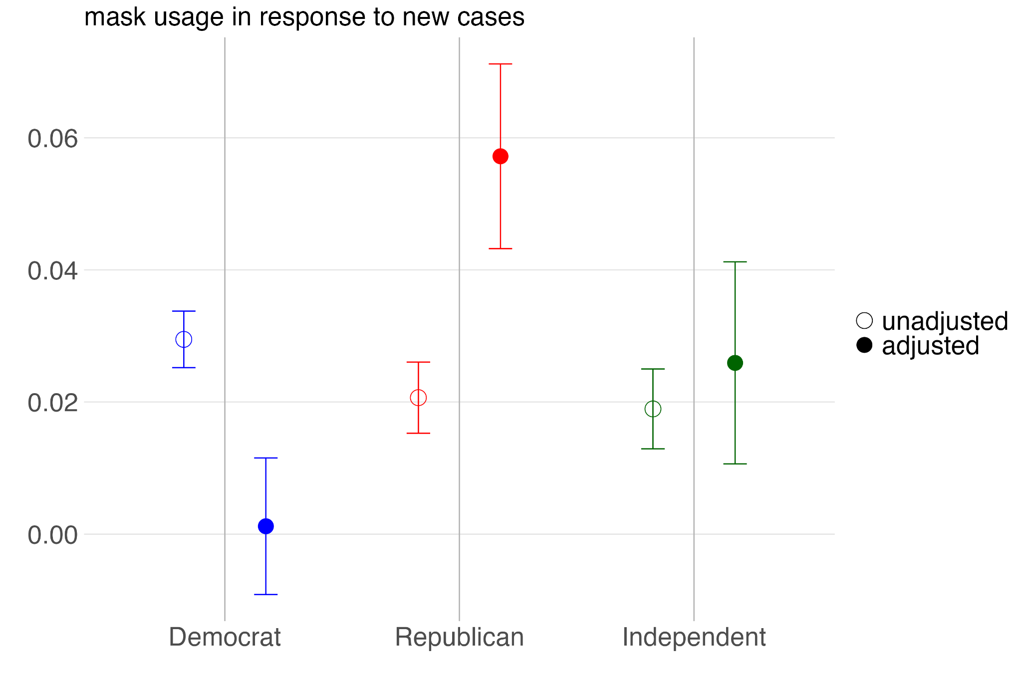
All groups react similarly to increased incidence when it comes to mask usage before controls
Notes:
a 4 point increase in the incidence per capita is associated with a 1 percent increase in mask usage
AD- Our data is cross sectional. We are not observing the same people over time. Longitudinal data may be better suited for studying how behavior changes over time.

Slide 24
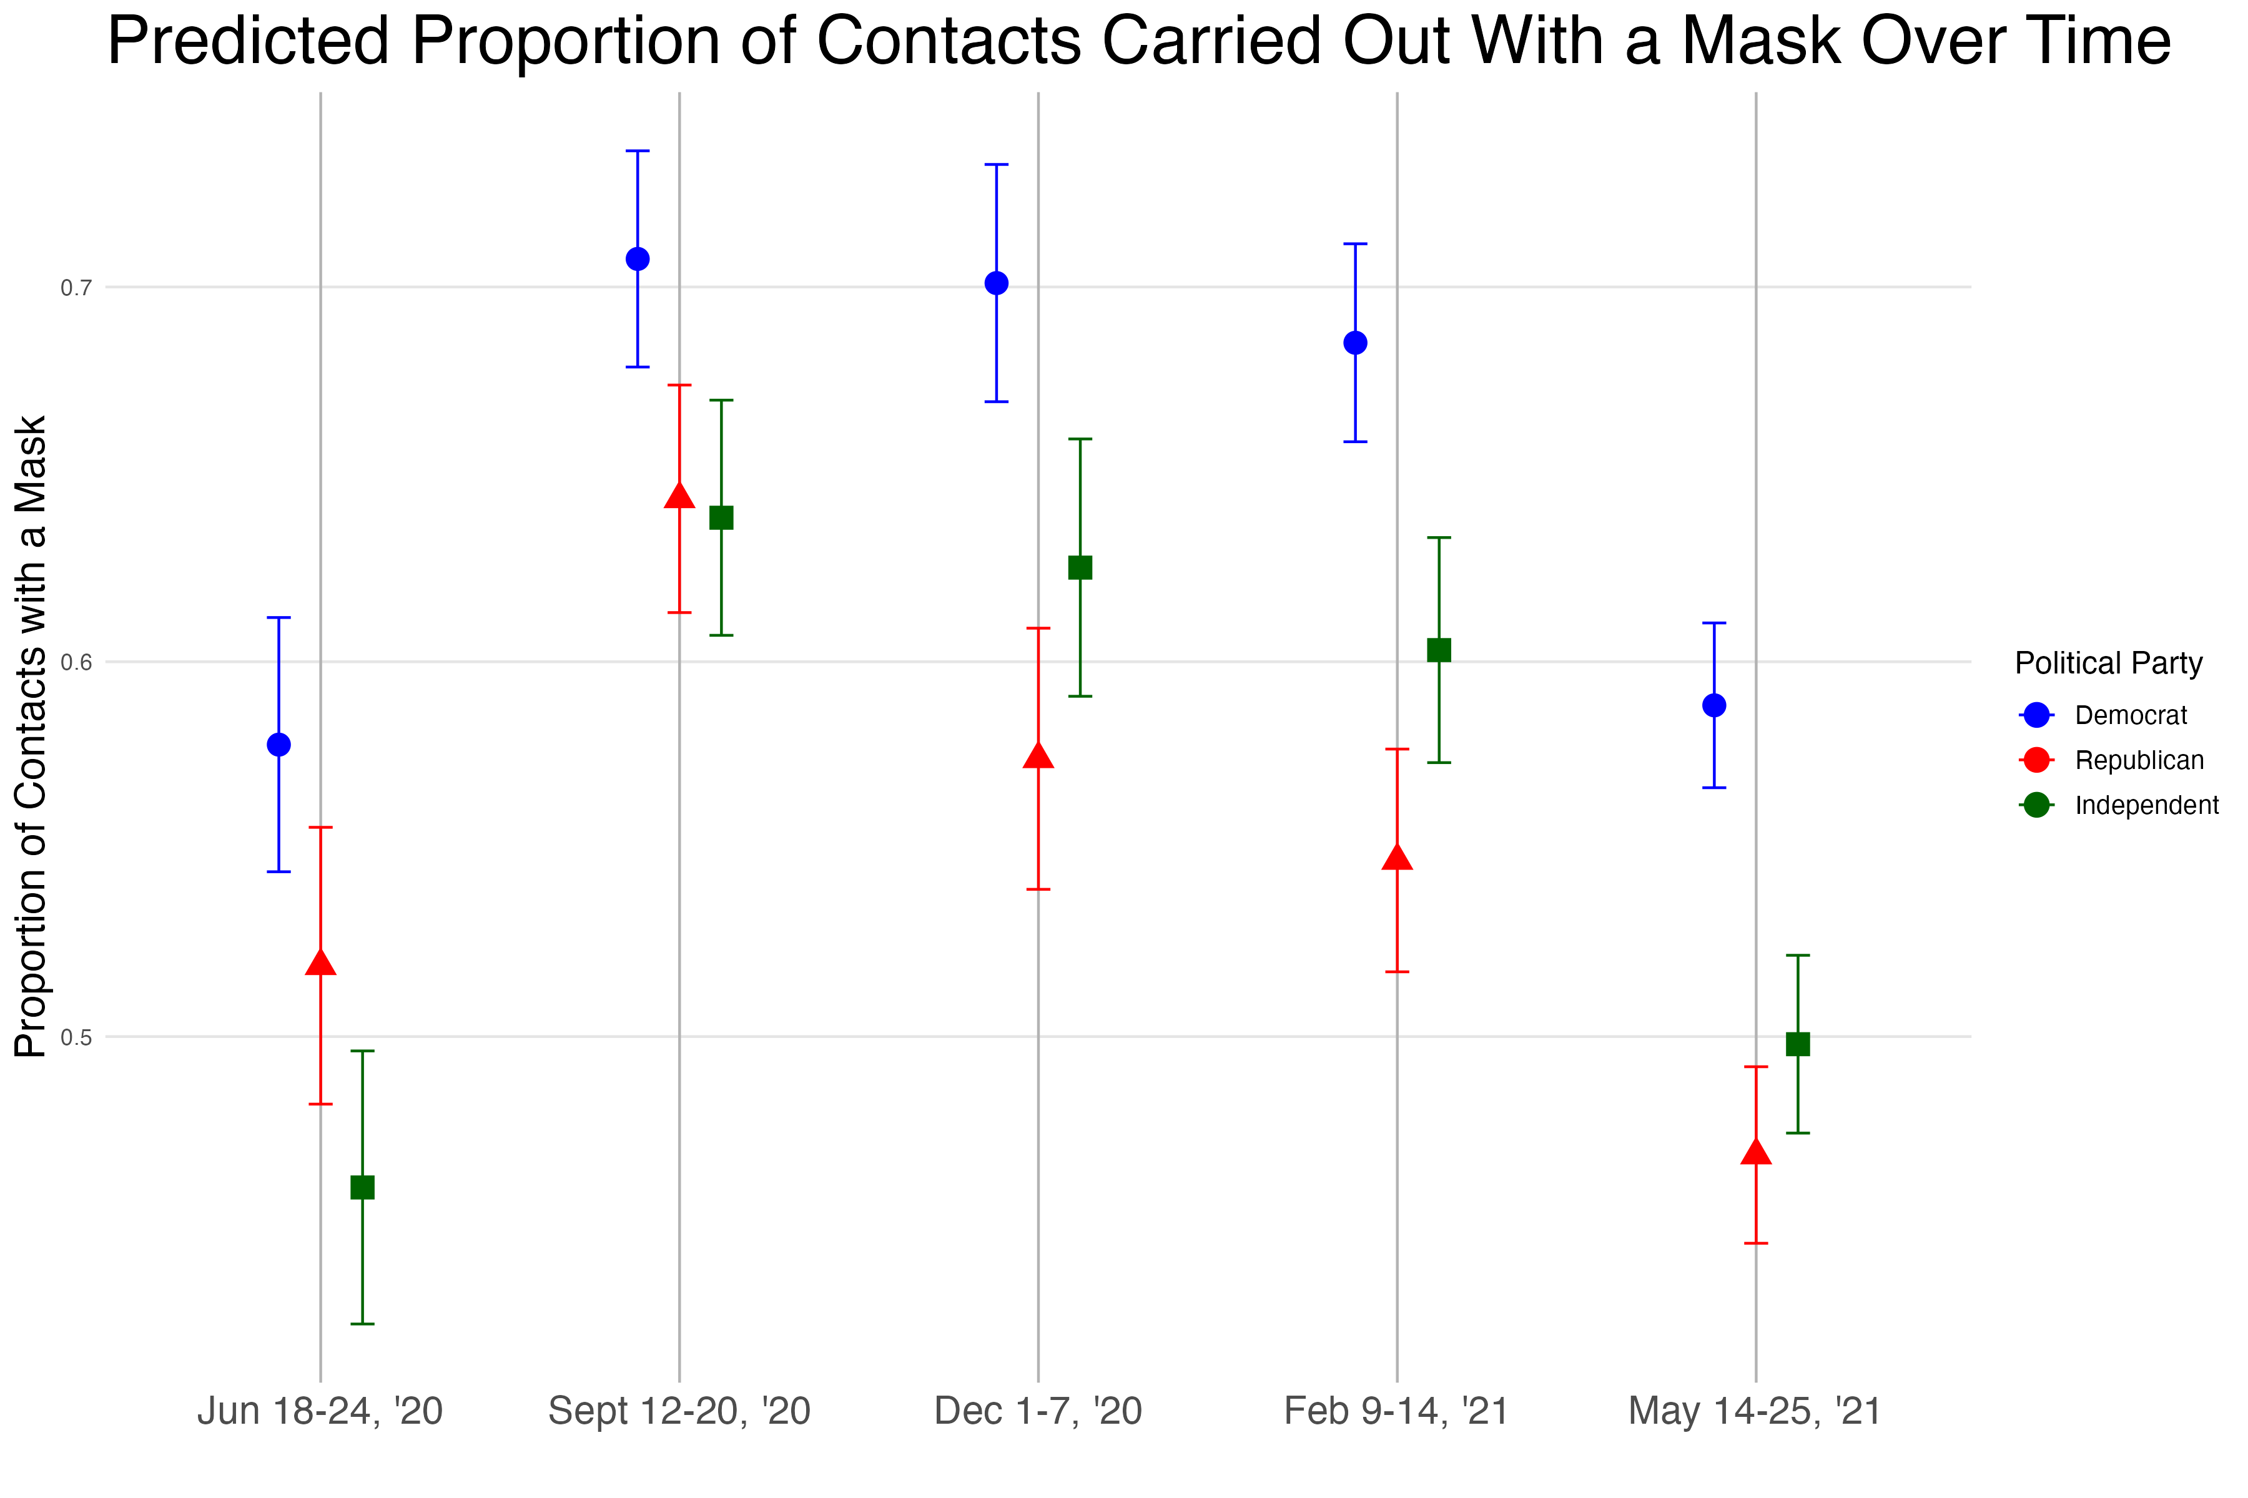

Slide 25
